Slide 1









Creation Date
<
>
10000
171
repositories
1
Initial Query
1
Initial Query

Slide 2
REST API
# of issues >= 1000
# of pull requests >= 1000
# of commits >= 1000
# of releases >= 50
Creation Date
<
32
repositories
>
10000
269188
issues
258711
pull requests
171
repositories
4584
releases
608033
commits
1
Initial Query
2
Filtering
3
Label Mapping

Slide 3
Dataset/Model | nlbse’22 nlbse’22 prepr. | MSc 3 labels bug – enhc – question nlbse’22 prepr. | MSc 3 labels bug – enhc – oos nlbse’22 prepr. | nlbse’22 MSc prepr. | MSc 3 labels bug – enhc – question MSc prepr. | MSc 3 labels bug – enhc – oos MSc prepr. | Llama3 8b instruct model bug – enhc – others
nlbse’22 nlbse’22 prepr. |  |  |  | - | - | - | -
MSc 3 labels bug – enhc – question nlbse’22 prepr. |  |  |  | - | - | - | -
MSc 3 labels bug – enhc – oos nlbse’22 prepr. |  |  |  | - | - | - | -
nlbse’22 MSc prepr. | - | - | - |  |  |  | -
MSc 3 labels bug – enhc – question MSc prepr. | - | - | - |  |  |  | -
MSc 3 labels bug – enhc – oos MSc prepr. | - | - | - |  |  |  | -
nlbse’22 test dataset without preprocessing | - | - | - | - | - | -
MSc 3 labels bug – enhc – question test dataset without preprocessing | - | - | - | - | - | -
MSc 3 labels bug – enhc – oos test dataset without preprocessing | - | - | - | - | - | -
1 - T | P | R | F1
bug | .89 | .90 | .90
enhc | .88 | .88 | .88
quest | .71 | .68 | .70
micro avg = .87
5 - E | P | R | F1
bug | .86 | .84 | .85
enhc | .82 | .87 | .84
quest | .54 | .44 | .48
micro avg = .82
8 - E | P | R | F1
bug | .89 | .70 | .78
enhc | .83 | .70 | .76
quest | .21 | .64 | .32
micro avg = .69
2 - E | P | R | F1
bug | .83 | .93 | .88
enhc | .85 | .78 | .81
quest | .70 | .49 | .58
micro avg = .83
4 - T | P | R | F1
bug | .90 | .92 | .91
enhc | .88 | .87 | .87
quest | .79 | .70 | .74
micro avg = .88
9 - E | P | R | F1
bug | .92 | .92 | .92
enhc | .94 | .86 | .90
quest | .63 | .81 | .71
micro avg = .88
3 - E | P | R | F1
bug | .53 | .93 | .68
enhc | .50 | .78 | .61
oos | .83 | .16 | .27
micro avg = .55
6 - E | P | R | F1
bug | .57 | .95 | .72
enhc | .56 | .91 | .69
oos | .92 | .21 | .34
micro avg = .60
7 - T | P | R | F1
bug | .83 | .88 | .85
enhc | .80 | .80 | .80
oos | .89 | .85 | .87
micro avg = .85
13 - T | P | R | F1
bug | .89 | .90 | .90
enhc | .88 | .88 | .88
quest | .71 | .67 | .69
micro avg = .87
17 - E | P | R | F1
bug | .85 | .86 | .85
enhc | .81 | .88 | .84
quest | .62 | .37 | .46
micro avg = .82
20 - E | P | R | F1
bug | .89 | .75 | .81
enhc | .82 | .74 | .78
quest | .24 | .59 | .35
micro avg = .73
14 - E | P | R | F1
bug | .84 | .92 | .88
enhc | .85 | .80 | .82
quest | .70 | .53 | .60
micro avg = .83
16 - T | P | R | F1
bug | .90 | .92 | .91
enhc | .88 | .87 | .88
quest | .78 | .71 | .74
micro avg = .88
21 - E | P | R | F1
bug | .93 | .91 | .92
enhc | .94 | .87 | .90
quest | .61 | .82 | .70
micro avg = .88
15 - E | P | R | F1
bug | .54 | .92 | .68
enhc | .50 | .80 | .62
oos | .83 | .18 | .29
micro avg = .55
18 - E | P | R | F1
bug | .57 | .96 | .72
enhc | .56 | .91 | .70
oos | .92 | .21 | .34
micro avg = .61
19 - T | P | R | F1
bug | .84 | .86 | .85
enhc | .80 | .80 | .80
oos | .88 | .86 | .87
micro avg = .85
10 - E | P | R | F1
bug | .84 | .88 | .86
enhc | .80 | .86 | .83
quest | .26 | .10 | .14
micro avg = .80
41 - E | P | R | F1
bug | .86 | .80 | .83
enhc | .74 | .78 | .76
quest | .15 | .19 | .17
micro avg = .73
11 - E | P | R | F1
bug | .79 | .95 | .86
enhc | .80 | .79 | .79
quest | .53 | .08 | .14
micro avg = .79
42 - E | P | R | F1
bug | .86 | .79 | .82
enhc | .74 | .77 | .76
quest | .15 | .19 | .17
micro avg = .73
12 - E | P | R | F1
bug | .50 | .95 | .66
enhc | .51 | .78 | .62
oos | .89 | .10 | .17
micro avg = .53

Slide 4
Issue classification yaptik, BERT ve Llama3 8b ile
BERT her zaman daha iyi sonuc veriyor
Llama3 few shot / label definition verdik ancak daha iyi olmadi
Bizim veri setimizde train ettigimizde nlbse22 performansi dusuk ve tam tersi
(% * +) ground truth label’lardan emin degiliz bug olanlar mesela enhancement olarak label lanmis olabilir. Misclassified olanlari gozden gecirmek. Mesela misclassified ama gercekten de bug gibi ve modelin bug demesi dogru olabilir, ornek alip bakabiliriz. Genelde issue’larin yanlis acilmasi bir problem, bunu gostermis olabiliriz.
(%) no_label olanlar, untriaged olanlari predict etmek veya modeli train etmek icin kullanmak semi-supervised kullanabiliriz.
bug classifier
(% * +) Preprocessing icin llama3 kullanip BERT ile classification yapip classification performansini arttirabilirsek
(+) wontfix tahmin etmek, BERT ile
Issue description readability metrikleri, kod blogu, stacktrace var mi ekleyebilir miyiz
kod metrikleri, issue sayilari, issue label’lari ile kod kalitesi ve issue sayisi arasinda correlation
Hangi issue hangi release’e ait olduguna ulasamamistik
(*) cost of quality, kod metriklerinden tahmin etmek
Hangi issue hangi release’e ait olduguna ulasamamistik

Slide 5
(% * +) ground truth label’lardan emin degiliz bug olanlar mesela enhancement olarak label lanmis olabilir. Misclassified olanlari gozden gecirmek. Mesela misclassified ama gercekten de bug gibi ve modelin bug demesi dogru olabilir, ornek alip bakabiliriz. Genelde issue’larin yanlis acilmasi bir problem, bunu gostermis olabiliriz.
1. Misclassified olan 20ser issue, text olarak, BERT icin hem Llama3 icin, hem nlbse22 hem de bizim veri setimiz
original title ve body
preprocessed title ve body
original label
re-assigned label
BERT predicted label
Llama3 8b predicted label
Llama3 70b predicted label
2. Bir model ile misclassified olan issue Llama3’de dogru mu
3. 70b nin sonuclarini kontrol edelim.
(llama3 temperature ve diger parametreler, daha once ayrica tanimlamamistim. )

Slide 6
Label Definitions
There are three categories in my issue classification which are: (i) bug report, (ii) enhancement report, (iii) something else.
A (i) bug report corresponds to an issue that is created to indicate an unexpected behavior of a software where an error or a problem is encountered.
An (ii) enhancement report corresponds to an issue that is created to request a new feature to be implemented in the software.
The issue which are not either a bug report or an enhancement report are classified as (iii) something else.

Slide 7
Label Definitions
There are three categories in my issue classification which are: (i) bug report, (ii) enhancement request, (iii) something else.
A (i) bug report corresponds to an issue that is created to indicate an unexpected behavior of a software where an error or a problem is encountered.
An (ii) enhancement request corresponds to an issue that is created to request a new feature to be implemented in the software.
The issue which are not either a bug report or an enhancement request are classified as (iii) something else.

Slide 8
Dataset/Model | nlbse’22 nlbse’22 prepr. | MSc 3 labels bug – enhc – question nlbse’22 prepr. | MSc 3 labels bug – enhc – oos nlbse’22 prepr. | nlbse’22 MSc prepr. | MSc 3 labels bug – enhc – question MSc prepr. | MSc 3 labels bug – enhc – oos MSc prepr. | Llama3 8b instruct model bug – enhc – others
nlbse’22 nlbse’22 prepr. |  |  |  | - | - | - | -
MSc 3 labels bug – enhc – question nlbse’22 prepr. |  |  |  | - | - | - | -
MSc 3 labels bug – enhc – oos nlbse’22 prepr. |  |  |  | - | - | - | -
nlbse’22 MSc prepr. | - | - | - |  |  |  | -
MSc 3 labels bug – enhc – question MSc prepr. | - | - | - |  |  |  | -
MSc 3 labels bug – enhc – oos MSc prepr. | - | - | - |  |  |  | -
nlbse’22 test dataset without preprocessing | - | - | - | - | - | -
nlbse’22 test dataset without preprocessing 8b few shot | - | - | - | - | - | -
nlbse’22 test dataset without preprocessing 8b only label definitions | - | - | - | - | - | -
1 - T | P | R | F1
bug | .89 | .90 | .90
enhc | .88 | .88 | .88
quest | .71 | .68 | .70
micro avg = .87
5 - E | P | R | F1
bug | .86 | .84 | .85
enhc | .82 | .87 | .84
quest | .54 | .44 | .48
micro avg = .82
8 - E | P | R | F1
bug | .89 | .70 | .78
enhc | .83 | .70 | .76
quest | .21 | .64 | .32
micro avg = .69
2 - E | P | R | F1
bug | .83 | .93 | .88
enhc | .85 | .78 | .81
quest | .70 | .49 | .58
micro avg = .83
4 - T | P | R | F1
bug | .90 | .92 | .91
enhc | .88 | .87 | .87
quest | .79 | .70 | .74
micro avg = .88
9 - E | P | R | F1
bug | .92 | .92 | .92
enhc | .94 | .86 | .90
quest | .63 | .81 | .71
micro avg = .88
3 - E | P | R | F1
bug | .53 | .93 | .68
enhc | .50 | .78 | .61
oos | .83 | .16 | .27
micro avg = .55
6 - E | P | R | F1
bug | .57 | .95 | .72
enhc | .56 | .91 | .69
oos | .92 | .21 | .34
micro avg = .60
7 - T | P | R | F1
bug | .83 | .88 | .85
enhc | .80 | .80 | .80
oos | .89 | .85 | .87
micro avg = .85
13 - T | P | R | F1
bug | .89 | .90 | .90
enhc | .88 | .88 | .88
quest | .71 | .67 | .69
micro avg = .87
17 - E | P | R | F1
bug | .85 | .86 | .85
enhc | .81 | .88 | .84
quest | .62 | .37 | .46
micro avg = .82
20 - E | P | R | F1
bug | .89 | .75 | .81
enhc | .82 | .74 | .78
quest | .24 | .59 | .35
micro avg = .73
14 - E | P | R | F1
bug | .84 | .92 | .88
enhc | .85 | .80 | .82
quest | .70 | .53 | .60
micro avg = .83
16 - T | P | R | F1
bug | .90 | .92 | .91
enhc | .88 | .87 | .88
quest | .78 | .71 | .74
micro avg = .88
21 - E | P | R | F1
bug | .93 | .91 | .92
enhc | .94 | .87 | .90
quest | .61 | .82 | .70
micro avg = .88
15 - E | P | R | F1
bug | .54 | .92 | .68
enhc | .50 | .80 | .62
oos | .83 | .18 | .29
micro avg = .55
18 - E | P | R | F1
bug | .57 | .96 | .72
enhc | .56 | .91 | .70
oos | .92 | .21 | .34
micro avg = .61
19 - T | P | R | F1
bug | .84 | .86 | .85
enhc | .80 | .80 | .80
oos | .88 | .86 | .87
micro avg = .85
10 - E | P | R | F1
bug | .84 | .88 | .86
enhc | .80 | .86 | .83
quest | .26 | .10 | .14
micro avg = .80
41 - E | P | R | F1
bug | .86 | .80 | .83
enhc | .74 | .78 | .76
quest | .15 | .19 | .17
micro avg = .73
42 - E | P | R | F1
bug | .86 | .79 | .82
enhc | .74 | .77 | .76
quest | .15 | .19 | .17
micro avg = .73

Slide 9
Dataset/Model | nlbse’22 nlbse’22 prepr. bug classifier | MSc 3 labels bug – enhc – question nlbse’22 prepr. | MSc 3 labels bug – enhc – oos nlbse’22 prepr. | nlbse’22 MSc prepr. bug classifier | MSc 3 labels bug – enhc – question MSc prepr. | MSc 3 labels bug – enhc – oos MSc prepr. | Llama3 8b instruct model bug classifier
nlbse’22 nlbse’22 prepr. |  |  |  | - | - | - | -
MSc 3 labels bug – enhc – question nlbse’22 prepr. |  |  |  | - | - | - | -
MSc 3 labels bug – enhc – oos nlbse’22 prepr. |  |  |  | - | - | - | -
nlbse’22 MSc prepr. | - | - | - |  |  |  | -
MSc 3 labels bug – enhc – question MSc prepr. | - | - | - |  |  |  | -
MSc 3 labels bug – enhc – oos MSc prepr. | - | - | - |  |  |  | -
nlbse’22 test dataset without preprocessing | - | - | - | - | - | -
MSc 3 labels bug – enhc – question test dataset without preprocessing | - | - | - | - | - | -
MSc 3 labels bug – enhc – oos test dataset without preprocessing | - | - | - | - | - | -
22 - T | P | R | F1
bug | .90 | .89 | .89
not-bug | .89 | .90 | .89
micro avg = .89
26 - E | P | R | F1
bug | . | . | .
enhc | . | . | .
quest | . | . | .
micro avg = .
29 - E | P | R | F1
bug | . | . | .
enhc | . | . | .
quest | . | . | .
micro avg = .
40 - E | P | R | F1
bug | .82 | .87 | .85
not-bug | .86 | .81 | .84
micro avg = .84
25 - T | P | R | F1
bug | . | . | .
enhc | . | . | .
quest | . | . | .
micro avg = .
30 - E | P | R | F1
bug | . | . | .
enhc | . | . | .
quest | . | . | .
micro avg = .
23 - E | P | R | F1
bug | . | . | .
enhc | . | . | .
quest | . | . | .
micro avg = .
24 - E | P | R | F1
bug | . | . | .
enhc | . | . | .
quest | . | . | .
micro avg = .
27 - E | P | R | F1
bug | . | . | .
enhc | . | . | .
quest | . | . | .
micro avg = .
28 - T | P | R | F1
bug | . | . | .
enhc | . | . | .
quest | . | . | .
micro avg = .
31 - T | P | R | F1
bug | . | . | .
enhc | . | . | .
quest | . | . | .
micro avg = .
35 - E | P | R | F1
bug | . | . | .
enhc | . | . | .
quest | . | . | .
micro avg = .
38 - E | P | R | F1
bug | .88 | .74 | .81
not-bug | .78 | .90 | .84
micro avg = .82
32 - E | P | R | F1
bug | . | . | .
enhc | . | . | .
quest | . | . | .
micro avg = .
34 - T | P | R | F1
bug | . | . | .
enhc | . | . | .
quest | . | . | .
micro avg = .
39 - E | P | R | F1
bug | .94 | .91 | .92
not-bug | .90 | .93 | .91
micro avg = .92
33 - E | P | R | F1
bug | . | . | .
enhc | . | . | .
quest | . | . | .
micro avg = .
36 - E | P | R | F1
bug | . | . | .
enhc | . | . | .
quest | . | . | .
micro avg = .
37 - T | P | R | F1
bug | .85 | .85 | .85
not-bug | .93 | .93 | .93
micro avg = .90
41 - E | P | R | F1
bug | . | . | .
enhc | . | . | .
quest | . | . | .
micro avg = .
42 - E | P | R | F1
bug | . | . | .
enhc | . | . | .
quest | . | . | .
micro avg = .
Notes:
NEXT: github roberta-0906/bug_clf_to_be_checked_issues_predicted_and_nlbse

Slide 10
Dataset/Model | nlbse’22 nlbse’22 prepr. enhc classifier | MSc 3 labels bug – enhc – question nlbse’22 prepr. | MSc 3 labels bug – enhc – oos nlbse’22 prepr. | nlbse’22 MSc prepr. enhc classifier | MSc 3 labels bug – enhc – question MSc prepr. | MSc 3 labels bug – enhc – oos MSc prepr. | Llama3 8b instruct model enhc classifier
nlbse’22 nlbse’22 prepr. |  |  |  | - | - | - | -
MSc 3 labels bug – enhc – question nlbse’22 prepr. |  |  |  | - | - | - | -
MSc 3 labels bug – enhc – oos nlbse’22 prepr. |  |  |  | - | - | - | -
nlbse’22 MSc prepr. | - | - | - |  |  |  | -
MSc 3 labels bug – enhc – question MSc prepr. | - | - | - |  |  |  | -
MSc 3 labels bug – enhc – oos MSc prepr. | - | - | - |  |  |  | -
nlbse’22 test dataset without preprocessing | - | - | - | - | - | -
MSc 3 labels bug – enhc – question test dataset without preprocessing | - | - | - | - | - | -
MSc 3 labels bug – enhc – oos test dataset without preprocessing | - | - | - | - | - | -
X - T | P | R | F1
bug | . | . | .
enhc | . | . | .
quest | . | . | .
micro avg = .
X - E | P | R | F1
bug | . | . | .
enhc | . | . | .
quest | . | . | .
micro avg = .
X - E | P | R | F1
bug | . | . | .
enhc | . | . | .
quest | . | . | .
micro avg = .
X - E | P | R | F1
bug | . | . | .
enhc | . | . | .
quest | . | . | .
micro avg = .
X - T | P | R | F1
bug | . | . | .
enhc | . | . | .
quest | . | . | .
micro avg = .
X - E | P | R | F1
bug | . | . | .
enhc | . | . | .
quest | . | . | .
micro avg = .
X - E | P | R | F1
bug | . | . | .
enhc | . | . | .
quest | . | . | .
micro avg = .
X - E | P | R | F1
bug | . | . | .
enhc | . | . | .
quest | . | . | .
micro avg = .
X - T | P | R | F1
bug | . | . | .
enhc | . | . | .
quest | . | . | .
micro avg = .
X - T | P | R | F1
bug | . | . | .
enhc | . | . | .
quest | . | . | .
micro avg = .
X - E | P | R | F1
bug | . | . | .
enhc | . | . | .
quest | . | . | .
micro avg = .
X - E | P | R | F1
bug | . | . | .
enhc | . | . | .
quest | . | . | .
micro avg = .
X - E | P | R | F1
bug | . | . | .
enhc | . | . | .
quest | . | . | .
micro avg = .
X - T | P | R | F1
bug | . | . | .
enhc | . | . | .
quest | . | . | .
micro avg = .
X - E | P | R | F1
bug | . | . | .
enhc | . | . | .
quest | . | . | .
micro avg = .
X - E | P | R | F1
bug | . | . | .
enhc | . | . | .
quest | . | . | .
micro avg = .
X - E | P | R | F1
bug | . | . | .
enhc | . | . | .
quest | . | . | .
micro avg = .
X - T | P | R | F1
bug | . | . | .
enhc | . | . | .
quest | . | . | .
micro avg = .
X - E | P | R | F1
bug | . | . | .
enhc | . | . | .
quest | . | . | .
micro avg = .
X - E | P | R | F1
bug | . | . | .
enhc | . | . | .
quest | . | . | .
micro avg = .
X - E | P | R | F1
bug | . | . | .
enhc | . | . | .
quest | . | . | .
micro avg = .

Slide 11
Datasets

Slide 12
OK
Dataset: nlbse’22
Train: https://tickettagger.blob.core.windows.net/datasets/github-labels-top3-803k-train.tar.gz
Test: https://tickettagger.blob.core.windows.net/datasets/github-labels-top3-803k-test.tar.gz
Initially: Train: 90% 722899 | Test: 10% 80518 | Total: 803417
Duplicate issues are removed only in the Train dataset, number of dropped issues: 26220
Final distribution is below:
Label/Dataset | Train | Train % | Test | Test % | Total
bug | 347678 | 50% | 40288 | 50% | 387966
enhancement | 290006 | 42% | 33203 | 41% | 323209
question | 58995 | 8% | 7027 | 9% | 66022
total | 696679 |  | 80518 |  | 777197

Slide 13
OK
Dataset: nlbse’22
Pre-processing steps:
Step | Train | Test | Train Issue Body | Train Issue Title | Test Issue Body | Test Issue Title
Removing duplicates based on issue URLs | +
Replacing functions |  |  | + |  | +
Replacing issue numbers |  |  | + | + | + | +
Converting to lower case |  |  | + | + | + | +
Removing punctuations |  |  | + | + | + | +
Removing non-ascii characters |  |  | + | + | + | +
Replacing fixed part of repo URL column | + | +
Replacing white spaces |  |  | + | + | + | +
Truncating columns |  |  | + | + | + | +
Concatenating issue columns into one | + | +

Slide 14
OK
Dataset: MSc bug – enhancement – question
The pre-processing steps of nlbse’22 study are applied to our dataset.
Test size is 10%.
Sampling is stratified based on labels.
Label/Dataset | Train | Train % | Test | Test % | Total
bug | 50995 | 54% | 5666 | 54% | 56661
enhancement | 32732 | 35% | 3637 | 35% | 36369
question | 11103 | 12% | 1234 | 12% | 12337
total | 94830 |  | 10537 |  | 105367

Slide 15
OK
Dataset: MSc bug – enhancement – out-of-scope (to-be-checked)
The pre-processing steps of nlbse’22 study are applied to our dataset.
Test size is 10%.
Sampling is stratified based on labels.
Label/Dataset | Train | Train % | Test | Test % | Total
out-of-scope | 70632 | 41% | 7848 | 41% | 78480
bug | 50995 | 30% | 5666 | 30% | 56661
enhancement | 32732 | 19% | 3637 | 19% | 36369
to-be-checked | 17033 | 10% | 1893 | 10% | 18926
total | 171392 |  | 19044 |  | 190436

Slide 16
OK
Dataset: MSc bug – enhancement – out-of-scope (to-be-checked)
The pre-processing steps of nlbse’22 study are applied to our dataset.
Test size is 10%.
Sampling is stratified based on labels.
Distribution without to-be-checked issues.
Label/Dataset | Train | Train % | Test | Test % | Total
out-of-scope | 70632 | 46% | 7848 | 46% | 78480
bug | 50995 | 23% | 5666 | 23% | 56661
enhancement | 32732 | 21% | 3637 | 21% | 36369
total | 154359 |  | 17151 |  | 171510

Slide 17
OK
Dataset: MSc
Pre-processing steps:
Step | Train | Test | Train Issue Body | Train Issue Title | Test Issue Body | Test Issue Title
Removing duplicates based on issue URLs | +
Replacing functions |  |  | + | + | + | +
Replacing issue numbers |  |  | + | + | + | +
Converting to lower case |  |  | + | + | + | +
Removing punctuations |  |  | + | + | + | +
Removing underscores |  |  | + | + | + | +
Removing new line character |  |  | + | + | + | +
Removing carriage return character |  |  | + | + | + | +
Removing non-ascii characters |  |  | + | + | + | +
Replacing fixed part of repo URL column | + | +
Replacing white spaces |  |  | + | + | + | +
Truncating columns |  |  | + | + | + | +
Concatenating issue columns into one | + | +

Slide 18
Model Results

Slide 19
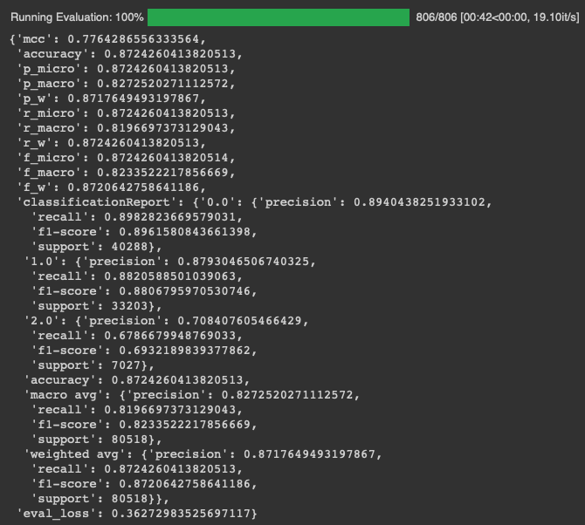
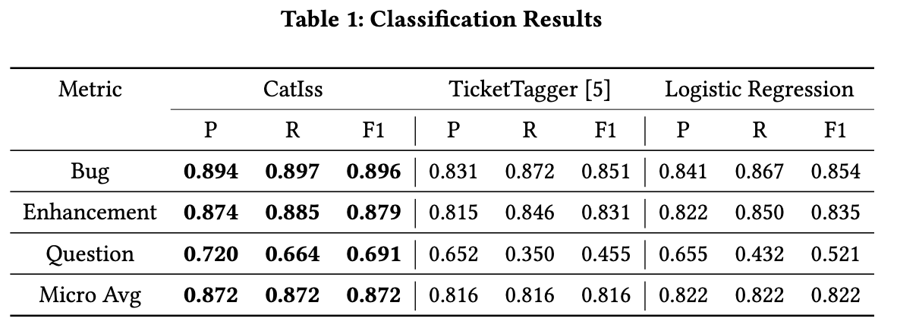
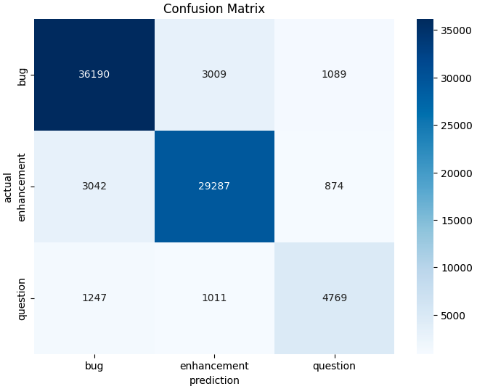
1 OK
Model: nlbse’22 & Dataset: nlbse’22

Slide 20
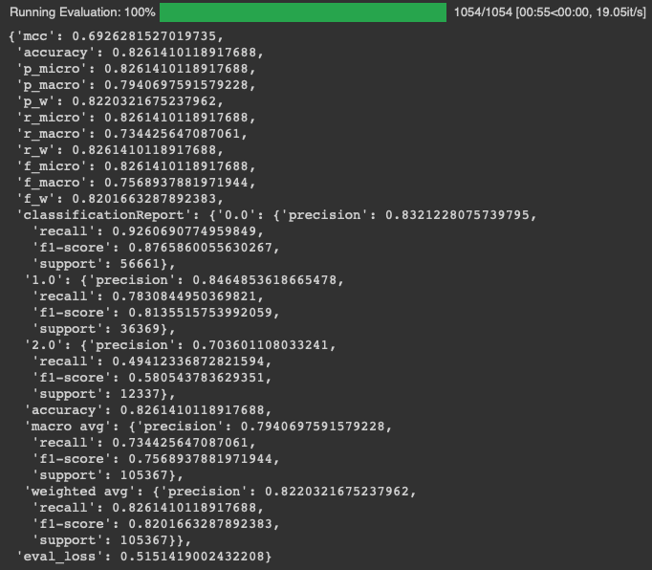
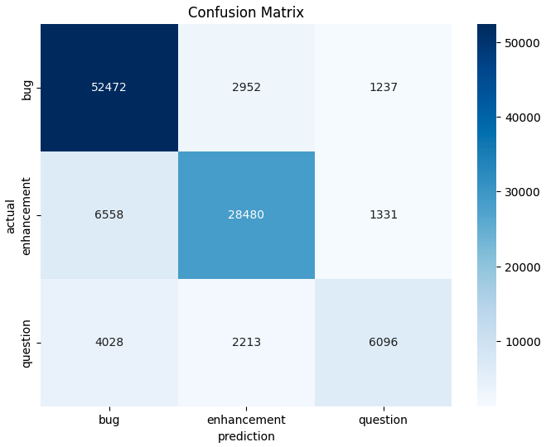
2 OK
Model: nlbse’22 & Dataset: MSc bug – enhancement – question

Slide 21
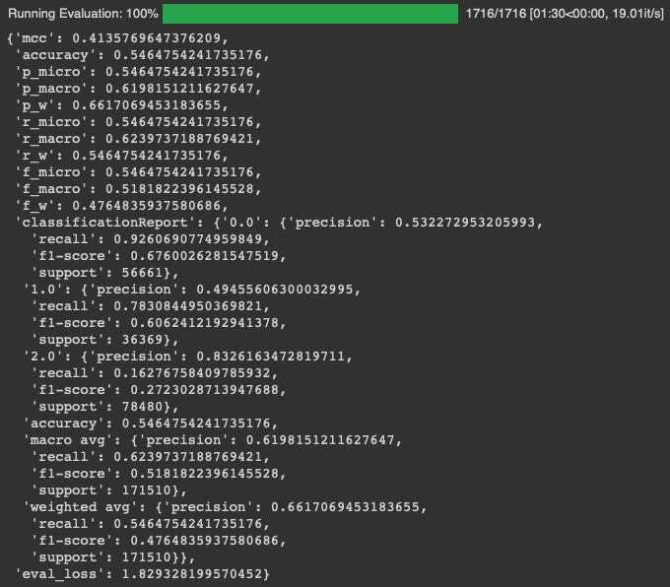
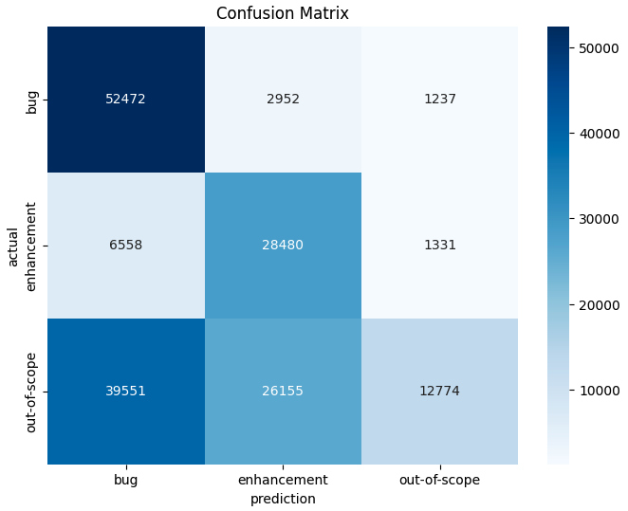
3 OK
Model: nlbse’22 & Dataset: MSc bug – enhancement – out-of-scope

Slide 22
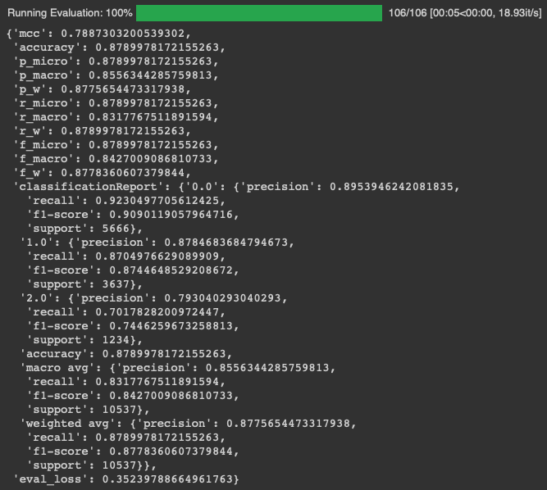
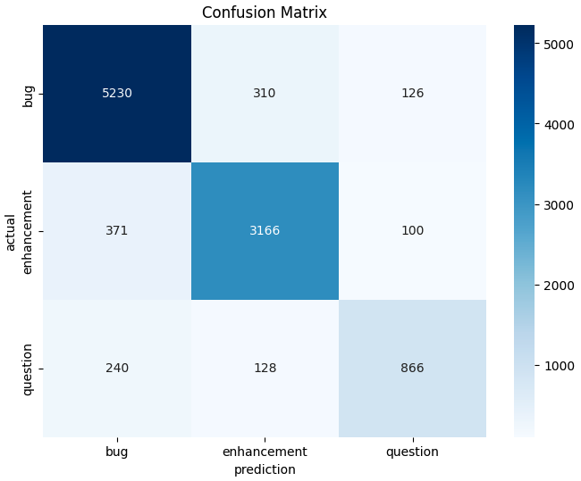
4 OK
Model: MSc bug – enhancement – question & Dataset: MSc bug – enhancement – question

Slide 23

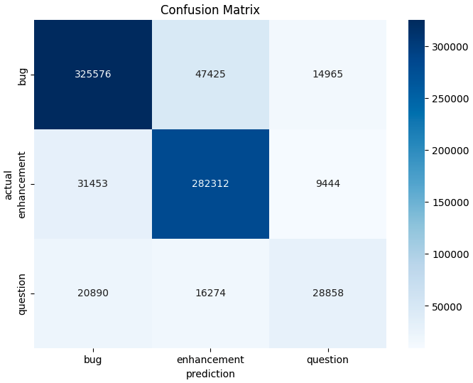
5 OK
Model: MSc bug – enhancement – question & Dataset: nlbse’22

Slide 24

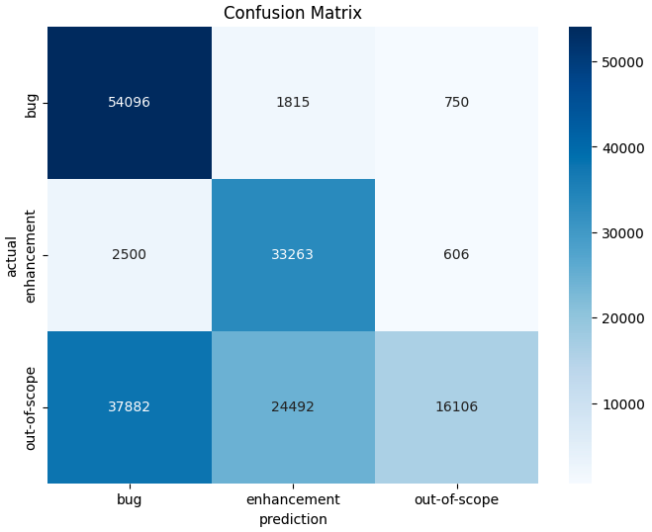
6 OK
Model: MSc bug – enhancement – question & Dataset: MSc bug – enhancement – out-of-scope

Slide 25

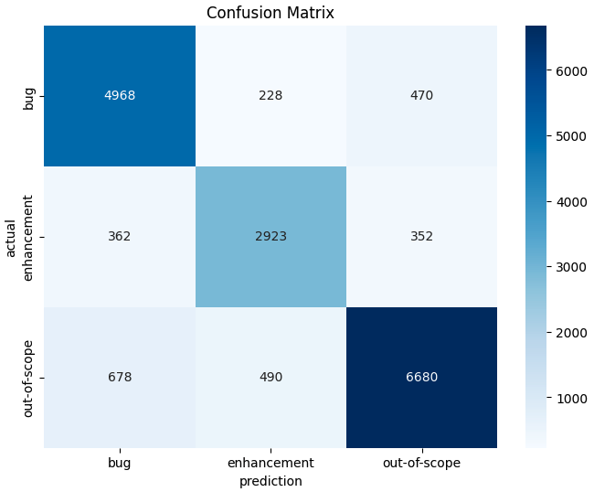
7 OK
Model: MSc bug – enhancement – out-of-scope & Dataset: MSc bug – enhancement – out-of-scope

Slide 26
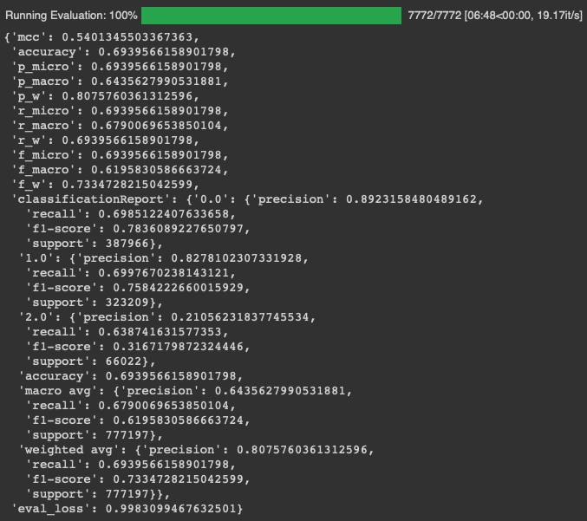
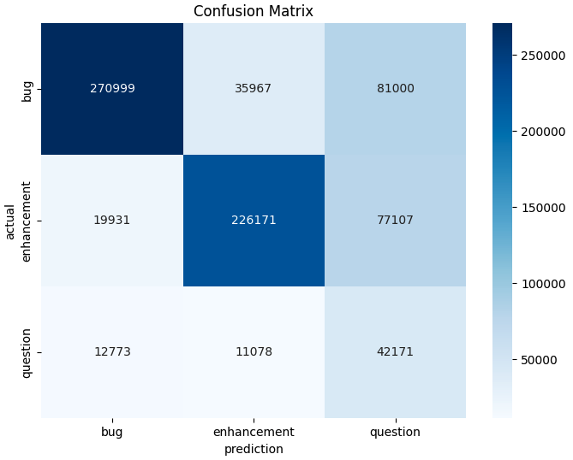
8 OK
Model: MSc bug – enhancement – out-of-scope & Dataset: nlbse’22

Slide 27
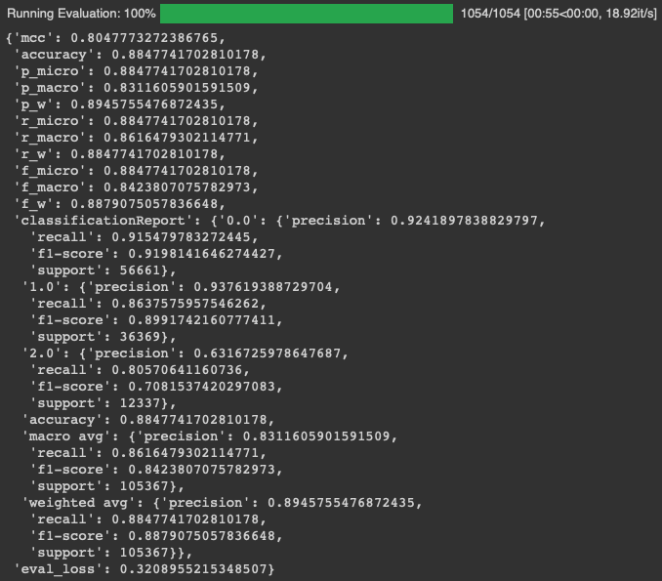
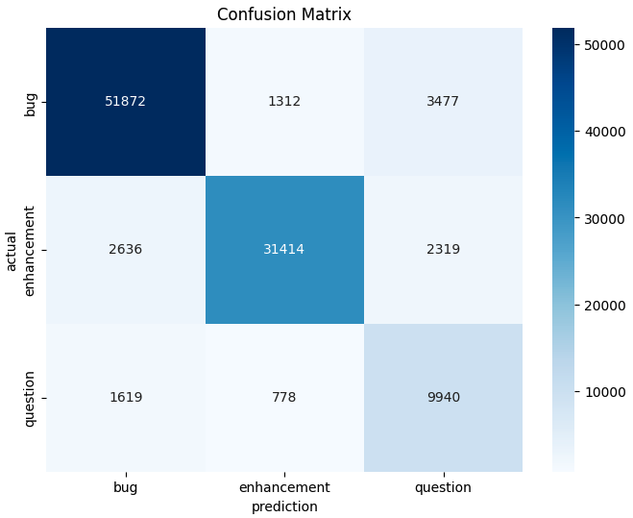
9 OK
Model: MSc bug – enhancement – out-of-scope & Dataset: MSc bug – enhancement – question

Slide 28
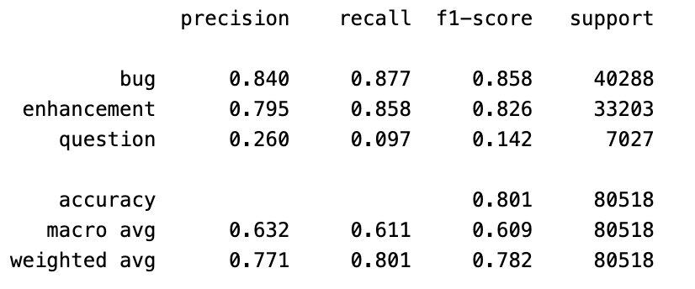
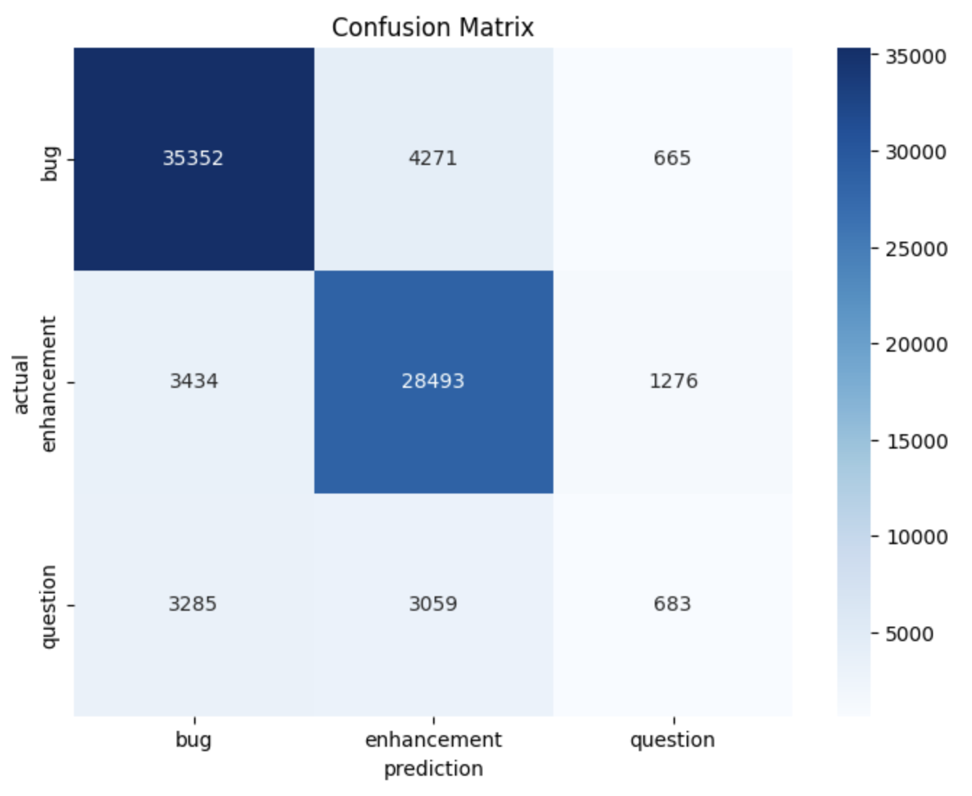
10 OK
Model: Llama3 bug – enhancement – other & Dataset: nlbse’22 test dataset without preprocessing
Notes:
/Users/isdeniz/Documents/Documents - isdeniz’s MacBook Pro/github/Summary-2406/llama3_nlbse22_test.ipynb
nlbse22_test_with_llama3_predictions.pkl
nlbse22_test_with_llama3_predictions_analysis.ipynb

Slide 29
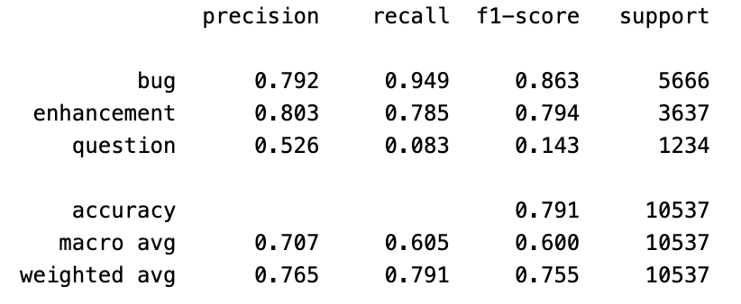
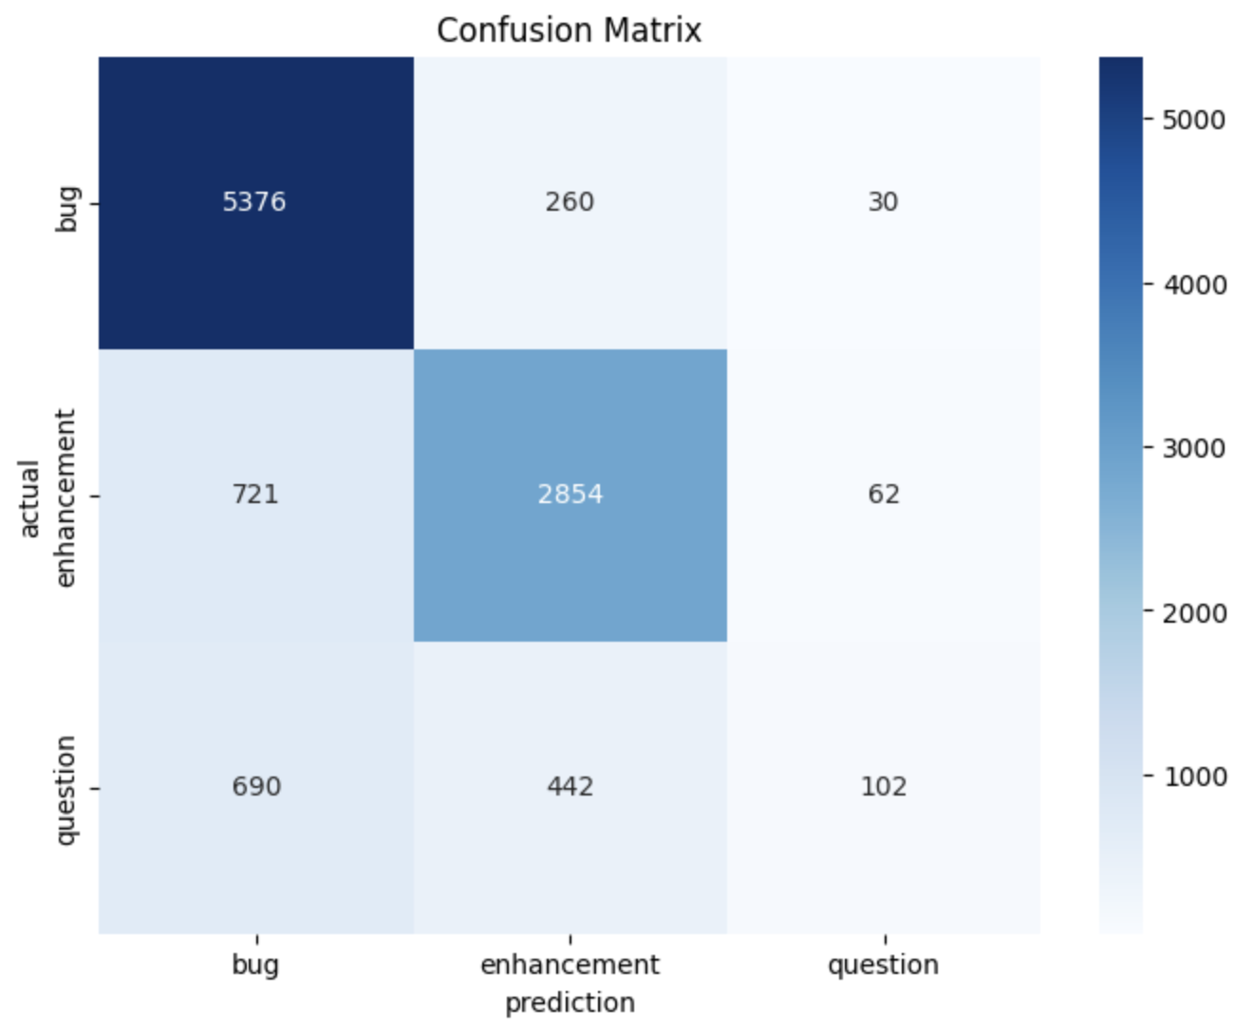
11 OK
Model: Llama3 bug – enhancement – other & Dataset: MSc bug – enhancement – question test dataset without preprocessing

Slide 30
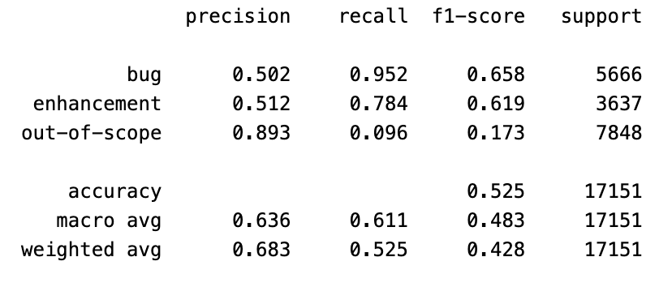
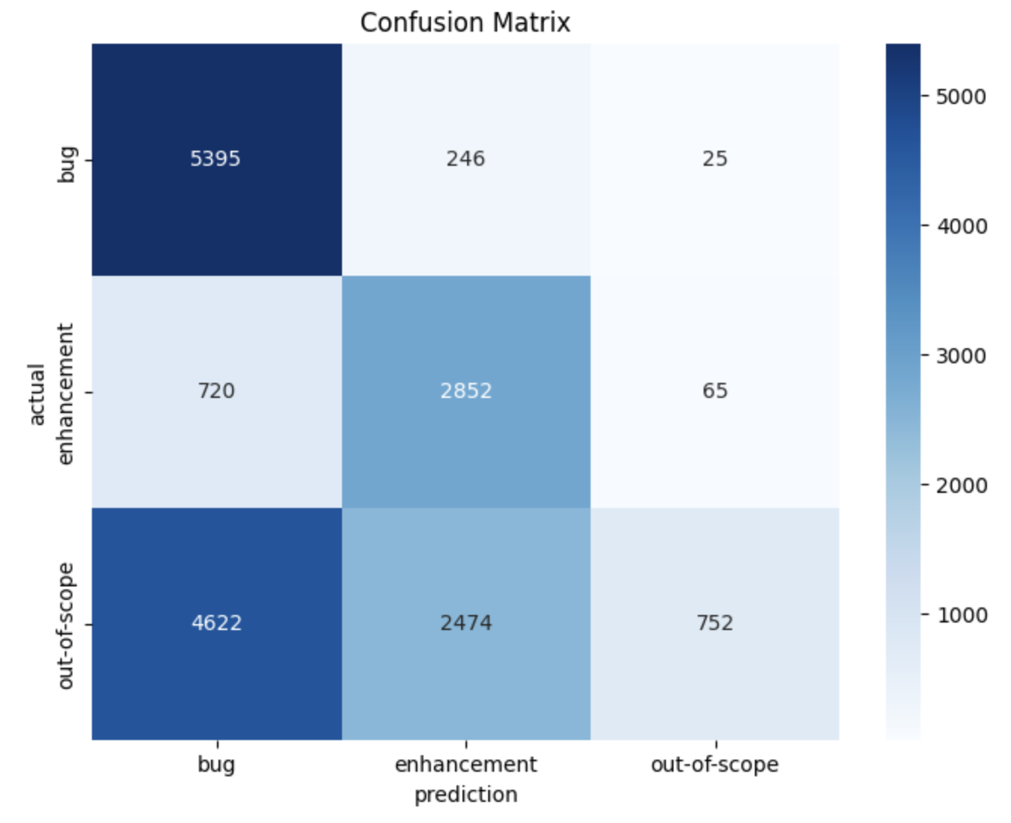
12 OK
Model: Llama3 bug – enhancement – other & Dataset: MSc bug – enhancement – out-of-scope test dataset without preprocessing

Slide 31
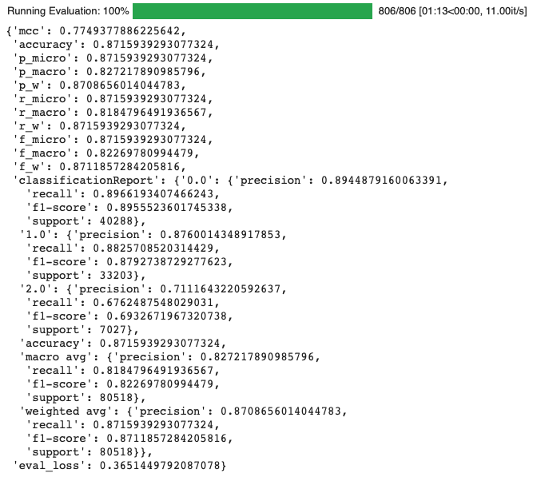

13 OK
Model: nlbse’22 & Dataset: nlbse’22 MSc Preprocessing

Slide 32
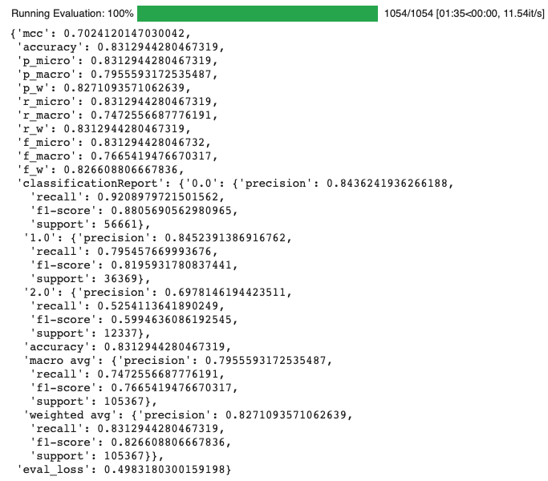
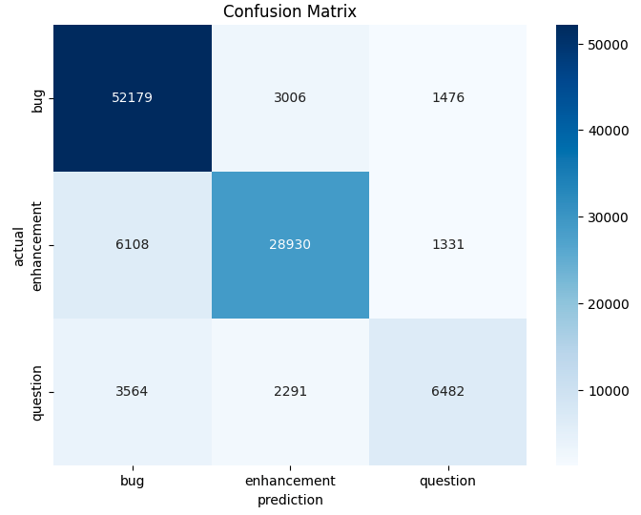
14 OK
Model: nlbse’22 & Dataset: MSc bug – enhancement – question MSc Preprocessing

Slide 33


15 OK
Model: nlbse’22 & Dataset: MSc bug – enhancement – out-of-scope MSc Preprocessing

Slide 34
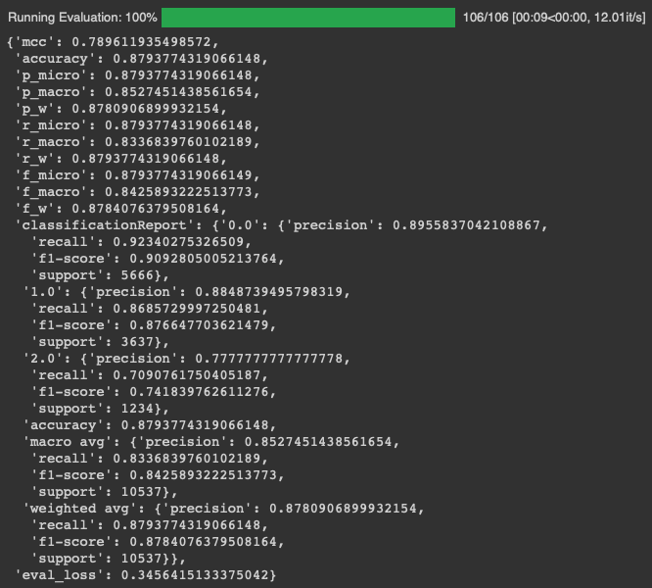
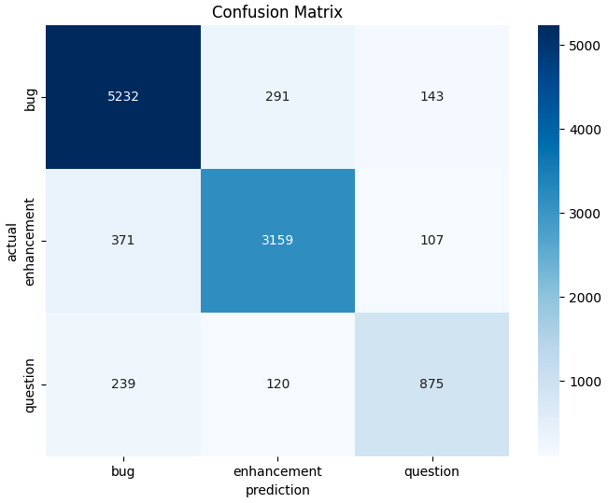
16 OK
Model: MSc bug – enhancement – question & Dataset: MSc bug – enhancement – question MSc Preprocessing

Slide 35

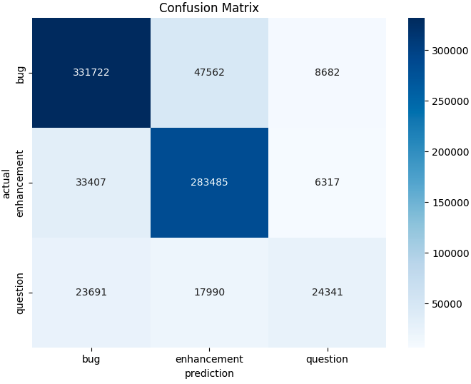
17 OK
Model: MSc bug – enhancement – question & Dataset: nlbse’22 MSc Preprocessing

Slide 36
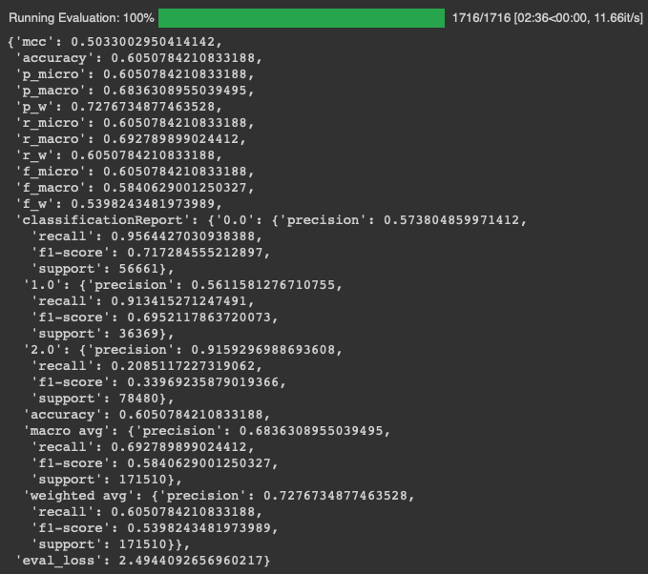
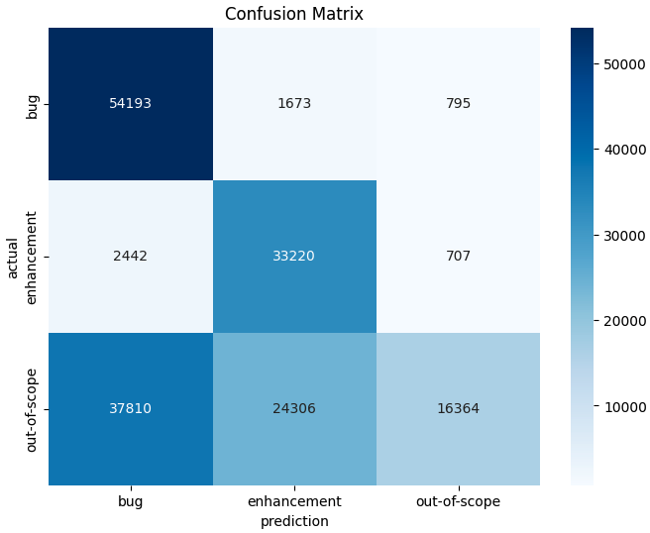
18 OK
Model: MSc bug – enhancement – question & Dataset: MSc bug – enhancement – out-of-scope MSc Preprocessing

Slide 37
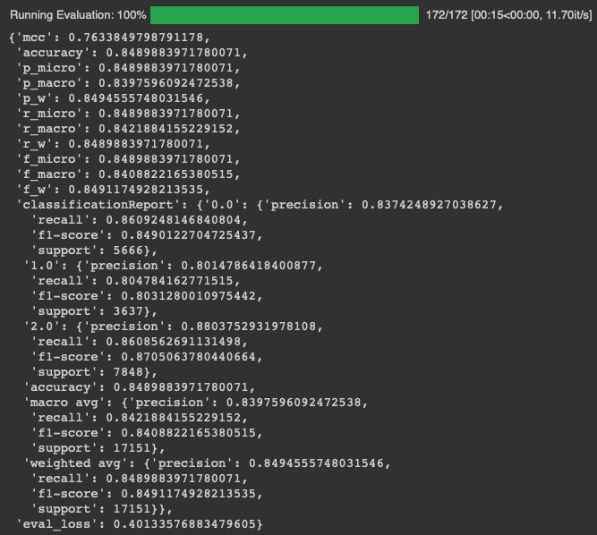

19 OK
Model: MSc bug – enhancement – out-of-scope & Dataset: MSc bug – enhancement – out-of-scope MSc Preprocessing

Slide 38
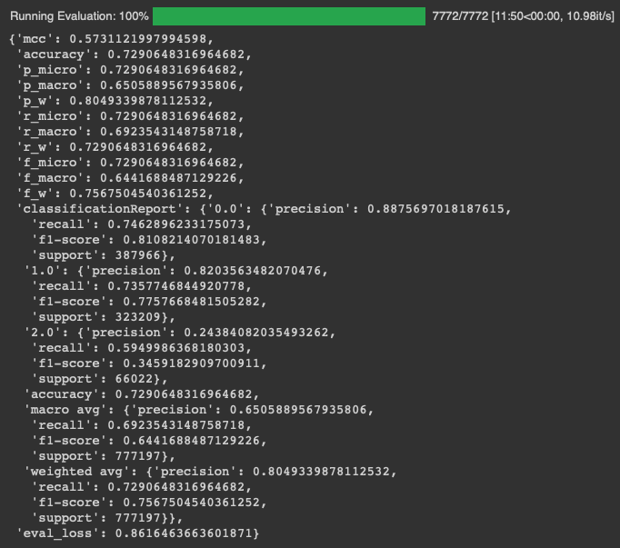
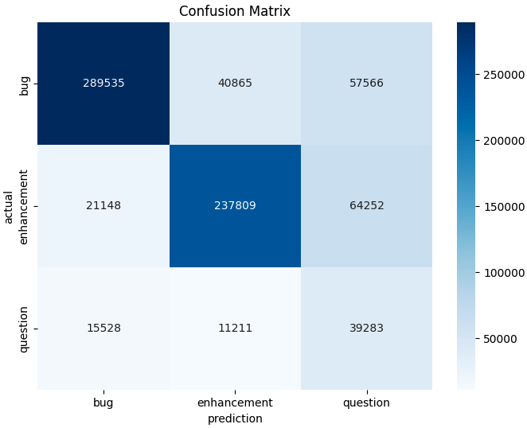
20 OK
Model: MSc bug – enhancement – out-of-scope & Dataset: nlbse’22 MSc Preprocessing

Slide 39
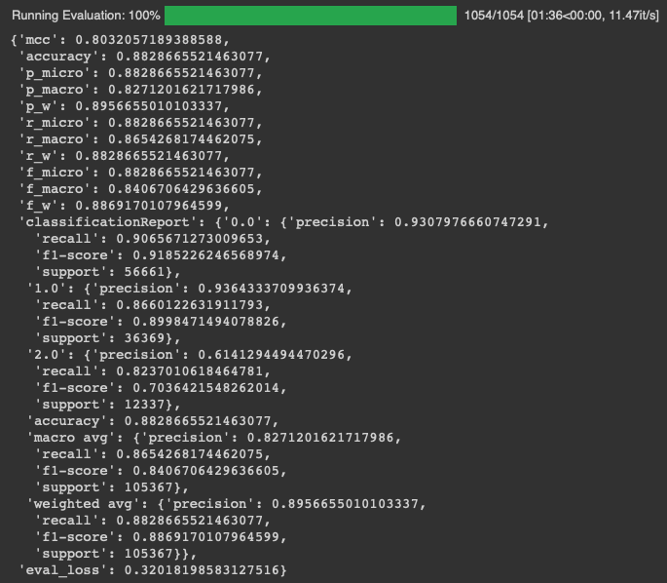
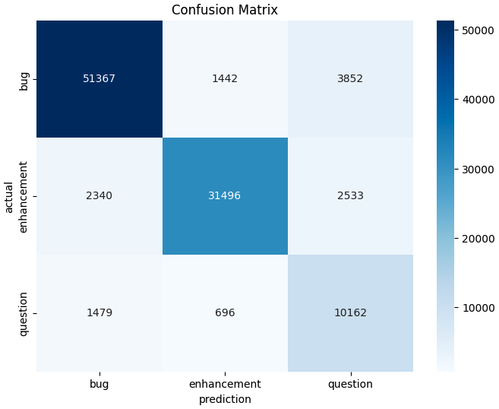
21 OK
Model: MSc bug – enhancement – out-of-scope & Dataset: MSc bug – enhancement – question MSc Preprocessing

Slide 40
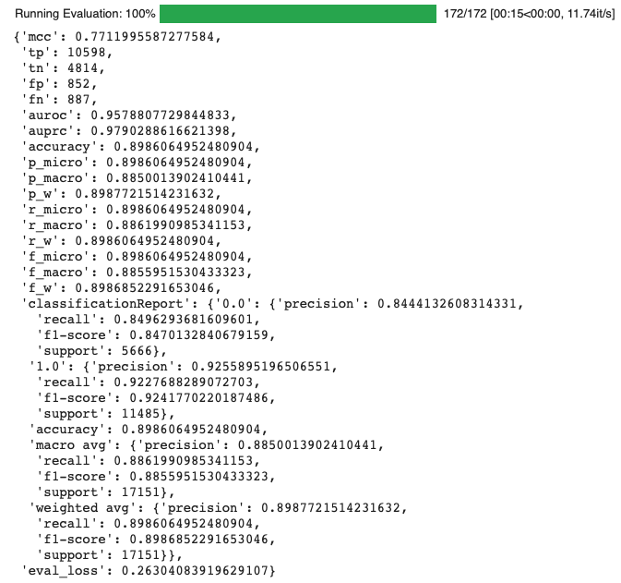
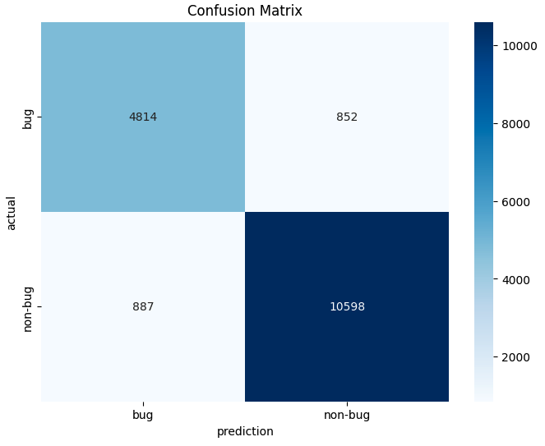
37 OK
Model: MSc bug – enhancement – out-of-scope & Dataset: MSc bug – enhancement – out-of-scope MSc Preprocessing BUG Classifier

Slide 41
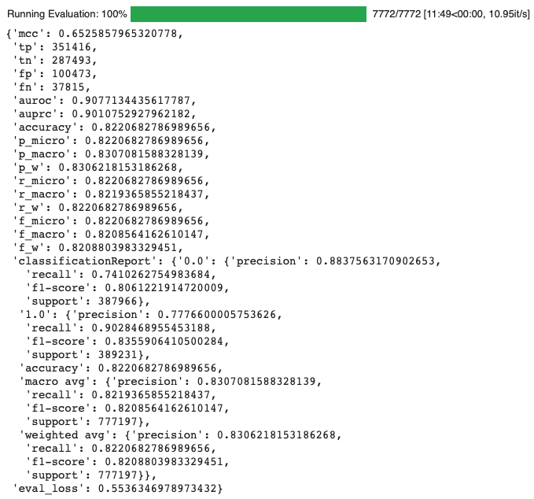
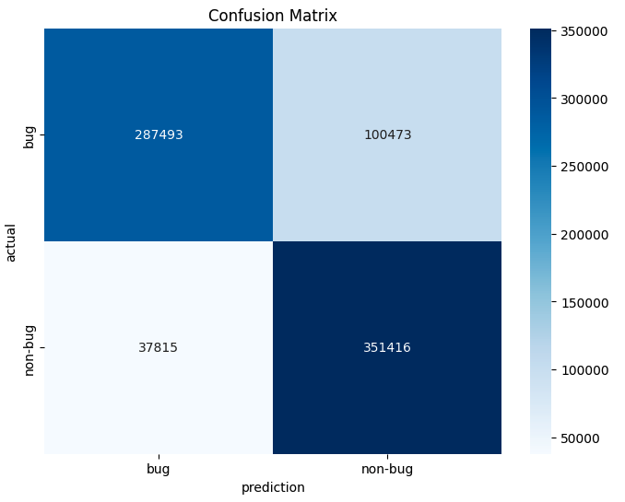
38 OK
Model: MSc bug – enhancement – out-of-scope & Dataset: nlbse’22 MSc Preprocessing BUG Classifier

Slide 42
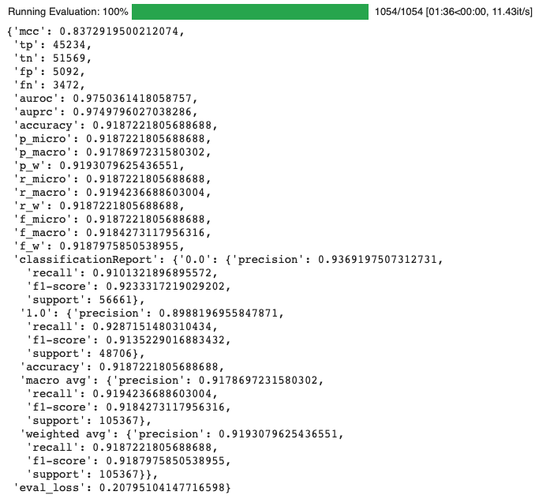
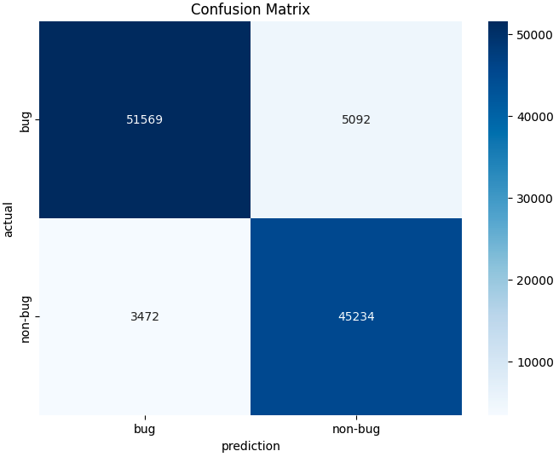
39 OK
Model: MSc bug – enhancement – out-of-scope & Dataset: MSc bug – enhancement – question MSc Preprocessing BUG Classifier

Slide 43
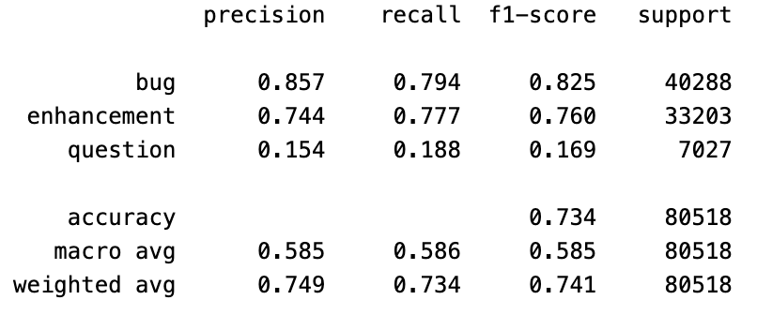
41 OK
Model: Llama3 bug – enhancement – other & Dataset: nlbse’22 test dataset without preprocessing – few shot
Notes:
/Users/isdeniz/Documents/Documents - isdeniz’s MacBook Pro/github/Summary-2406/nlbse22_few_shot_llama3_8b_v2.ipynb

Slide 44
42 OK
Model: Llama3 bug – enhancement – other & Dataset: nlbse’22 test dataset without preprocessing – label definitions
Notes:
/Users/isdeniz/Documents/Documents - isdeniz’s MacBook Pro/github/Summary-2406/nlbse22_few_shot_llama3_8b_v2.ipynb

Slide 45
Dataset: MSc & Model: nlbse’22
https://medium.com/@erkajalkumari/how-to-run-llama-3-locally-0f9426708d83#:~:text=Running%20Llama%203%20Locally,-Llama%203%20with&text=If%20your%20system%20has%20enough,be%20on%20the%20slower%20side.

Slide 46
Dataset/Model | nlbse’22 nlbse’22 prepr. | MSc 3 labels bug – enhc – question nlbse’22 prepr. | nlbse’22 MSc prepr. | MSc 3 labels bug – enhc – question MSc prepr. | Llama3 8b instruct model bug – enhc – question
nlbse’22 nlbse’22 prepr. |  |  | - | - | -
MSc 3 labels bug – enhc – question nlbse’22 prepr. |  |  | - | - | -
nlbse’22 MSc prepr. | - | - |  |  | -
MSc 3 labels bug – enhc – question MSc prepr. | - | - |  |  | -
nlbse’22 test dataset without preprocessing | - | - | - | -
MSc 3 labels bug – enhc – question test dataset without preprocessing | - | - | - | -
1 - T | P | R | F1
bug | .894 | .897 | .896
enhc | .874 | .885 | .879
quest | .720 | .664 | .691
micro avg = .872
4 - E | P | R | F1
bug | .860 | .845 | .852
enhc | .801 | .889 | .842
quest | .593 | .341 | .433
micro avg = .820
2 - E | P | R | F1
bug | .845 | .921 | .881
enhc | .840 | .812 | .825
quest | .707 | .484 | .574
micro avg = .832
3 - T | P | R | F1
bug | .895 | .926 | .910
enhc | .888 | .867 | .877
quest | .792 | .724 | .756
micro avg = .882
5 - T | P | R | F1
bug | . | . | .
enhc | . | . | .
quest | . | . | .
micro avg = .
8 - T | P | R | F1
bug | . | . | .
enhc | . | . | .
quest | . | . | .
micro avg = .
6 - E | P | R | F1
bug | . | . | .
enhc | . | . | .
quest | . | . | .
micro avg = .
7 - E | P | R | F1
bug | . | . | .
enhc | . | . | .
quest | . | . | .
micro avg = .
9 - E | P | R | F1
bug | . | . | .
enhc | . | . | .
quest | . | . | .
micro avg = .
10 - E | P | R | F1
bug | . | . | .
enhc | . | . | .
quest | . | . | .
micro avg = .

Slide 47
Summary
Dataset/Model | nlbse’22 | MSc | Llama3 | bug MSc | enhc MSc

Slide 48
Datasets
nlbse’22 dataset & nlbse’22 preprocessing steps
/Users/isdeniz/Documents/github/Summary-2406/data/test_clean_concat_200.csv
/Users/isdeniz/Documents/github/Summary-2406/data/train_clean_concat_200.csv
nlbse’22 dataset & MSc preprocessing steps
MSc dataset & nlbse’22 preprocessing steps
/Users/isdeniz/Documents/github/Summary-2406/msc-dataset-bug-enhc-question-nlbse22-preprocessing/data/test_bug_enhc_ques_nlbse22_preprocessing_200.csv
/Users/isdeniz/Documents/github/Summary-2406/msc-dataset-bug-enhc-question-nlbse22-preprocessing/data/train_bug_enhc_ques_nlbse22_preprocessing_200.csv
bug-enhc-oos-tbc train
bug-enhc-oos-tbc test
MSc dataset & MSc preprocessing steps
https://ollama.com/library/llama3

